Slide 1
UCONN FOUNDATION 2025 STUDENT DIRECTOR ELECTION PACKET
January 15, 2025

Slide 2
MATERIALS
Student Director Opportunities & Responsibilities
Election Timeline
Campaign Rules
Forms:
Part I: Intent to Run/Application
Part II: Petition of Nominations
Part III: Financial Statement

Slide 3
STUDENT DIRECTOR OPPORTUNITIES & RESPONSIBILITIES
OPPORTUNITIES
RESPONSIBILITIES
Participate as an active, non-voting member of the UConn Foundation board as a prominent student leader.
Contribute to fundraising and engagement efforts to keep alumni connected with UConn after graduation.
Engage the current UConn student body in the important work of the UConn Foundation to help grow future philanthropy and alumni engagement.
Participate in UConn Foundation board related events as a representative of the student body.
Develop relationships with UConn Foundation board members and build your professional network.
Attend UConn Foundation board meetings (3/year).
Attend UConn Foundation assigned committee meetings (typically 3-5/year).
Attend UConn’s “Student Alumni Association” meetings to report back to the Foundation’s Board on student fundraising efforts (occasionally).
Attend Undergraduate Student Government, regional campus student governments, and Graduate Student Senate executive board meetings to communicate about the role of the UConn Foundation (occasionally).

Slide 4
2025 STUDENT DIRECTOR TIMELINE
JANUARY 2025
FEBRUARY 2025
January 21 - Application Forms Available
Election packet, applications and other required forms are available on UConn Elections Website (https://vote.uconn.edu/jointelections-run-for-office/ )
January 23 - Information Session, 12:00 pm
Foundation virtual information session.
RSVP to Judy Smith, at jsmith@foundation.uconn.edu for details
January 31 - Completed Intent to Run Forms Due by 12:00 pm
February 14:
Completed Applications Due by 12:00 pm
Applications must include a statement of position or biographical summary (limited to 175 words) and a completed Petition of Nomination.
Petition of Nomination is created for candidates on the UConntact system to collect electronic signatures from 50 students plus one percent of the registered UConn students at your home campus. Any registered UConn student at any campus may electronically sign your petition by entering their first and last name, campus affiliation, and NetID.
Certification of Candidates for Foundation Student Director Election
Once all the forms are received and reviewed, Krista O’Brien, Director of Trustee Student Organization Support, will notify candidates of their eligibility via e-mail.
Campaigning Begins After Candidate’s Receive Confirmation of Eligibility

Slide 5
2025 STUDENT DIRECTOR TIMELINE
March 2025
OCTOBER 2025
March 4 at 12:00 pm Voting begins at www.vote.uconn.edu
March 6 at 12:00 pm - Voting Ends
March 6 at 3:00 pm, Deadline to Submit:
Financial statements recording campaign receipts and expenditures; and
Alleged campaign violations to Voteatuconn@uconn.edu (Attn: Jose Maldonado)
March 6 at 3:00 pm – Validation of the Election
Following validation, Jose Maldonado, Coordinator of Trustee Student Organization Advising OR Krista O'Brien, Director of Trustee Student Organization Support, notifies Foundation Representative, Judy Smith, who will notify candidates via e-mail.
March 7-8 – Appeal of the Election
Any candidate wishing to appeal the results of the election must send an e-mail to the Foundation attn: Judy Smith, at jsmith@foundation.uconn.edu, within 24 hours of the March 6th notification.
March 17-18 – If No Outstanding Appeals
Foundation releases results of the election released to the press
Student Director Introduced to the Foundation Board at its October Meeting (Date/Time – TBD)
Campaign Withdrawal
Candidates wishing to withdraw their candidacy shall send a letter of withdrawal by 12:00 pm on February 27, 2025 to Judy Smith, Student Director Election representative, by e-mail at jsmith@foundation.uconn.edu.
Upon receipt of the letter of withdrawal the candidate’s name will be removed from the ballot and website.

Slide 6
CAMPAIGN RULES AND POSITION REQUIREMENTS
Requirements for candidacy for the office of UConn Foundation Student Director are as follows:
Prospective candidates:
Must be a student enrolled at the University of Connecticut at the time of election;
Must remain in good academic and student conduct standing for the duration of their directorship;
The standard director term is two (2) years. It is desirable, but not required, that candidates have two or more years remaining in their planned UConn program to serve the entire term.
Student director candidates should follow the University’s “Campaign and Election Rules for Student Elections” for operating and running a campaign at https://vote.uconn.edu/jointelections-run-for-office/.

Slide 7
UNIVERSITY’S CAMPAIGN AND ELECTION RULES FOR STUDENT ELECTIONS
Campaign Activity / University Policies
Campaign activity is defined as soliciting support for a campaign on behalf of oneself or another. All candidates, and those working for or on behalf of any candidates must adhere to all University policies, including (but not limited to) the Student Code and various posting policies. Failure to adhere may result in disqualification from the election at the discretion of the Foundation.
The rules and policies are included at https://vote.uconn.edu/jointelections-run-for-office/ under the “Information for Prospective Candidates” tab.

Slide 8
UNIVERSITY’S CAMPAIGN AND ELECTION RULES FOR STUDENT ELECTIONS
Campaign Spending & Accounting
Personal Expenditures:
Campaign Contributions:
Donations of Goods, Professional Services, and Personal Items:
Travel:
Maximum Expenditures:
Raffles / Drawings:
Campaign Fund Accounting:
No candidate shall spend more than one hundred dollars ($100) of their personal funds for campaign purposes, excluding personal travel expenditures.
Candidates may accept campaign contributions, provided, however, that no more than $100 in contributions is allowed. Candidates may also accept campaign contributions not to exceed twenty-five dollars ($25) per donor or one hundred dollars ($100) in the aggregate.
Fair market value of all donated goods, professional services, and personal items used in the campaign shall be included as expenditures and shall be treated in the same manner as contributions in determining whether the candidate has observed the regulated limits. Personal supplies are consumable goods such as (but not limited to) computer paper, cake mixes, markers, etc.
If a candidate travels to campaign, fuel public transportation costs, Uber/Lyft costs, etc. are not included as a campaign expense.
The total amount expended for the campaign may not exceed two hundred dollars ($200), including the value of donated goods, professional services, and personal supplies.
Candidates are not allowed to hold raffles or drawings as part of their campaigns.
A final report of campaign receipts and expenditures along with all supporting documents must be prepared and submitted via the official form by each candidate. This form must be submitted whether or not monies were spent on the campaign (see Timeline above).

Slide 9
University’s Campaign and Election Rules for Student Elections
Limitations of Campaign
Campaign Violations
Per the student code (III B 2-5) coercion is prohibited by the University.
Candidates may not use the University’s official announcements or the Daily Digest to campaign. All activity on all other official and unofficial listservs is permitted.
All campaign activity must comply with federal, state, local and University health and safety rules.
Alleged violations of campaign rules and regulations shall be referred to, in writing via email to voteatuconnn@uconn.edu (Attention: Jose Maldonado) by 3:00 pm on March 6, 2025.
Review of violations shall be at the discretion of the UConn Foundation.
Appropriate action may entail disqualifying a candidate should they be found in violation of campaign rules or regulations.
The decisions of the UConn Foundation are final.

Slide 10
Forms:
Part I Intent to Run/ Application | Part II Petition of Nomination | Part III Financial Statement

Slide 11
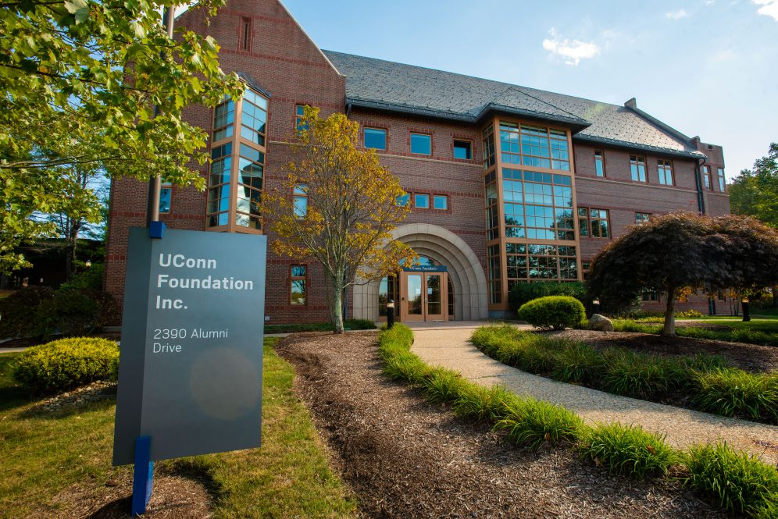
Thank you for your interest in the student director position on the UConn Foundation’s Board of Directors. Your willingness to campaign for this important leadership role is a positive reflection of your commitment to the University. This truly is a great way to give back to UConn!!
Questions? Contact Judy Smith, at jsmith@foundation.uconn.edu
Information regarding the specifics of the Campaign process can be obtained through the Department of Student Activities by emailing voteatuconn@uconn.edu or by visiting https://vote.uconn.edu/jointelections-run-for-office/

